Slide 1
Protocols and Architecture

Slide 2
Need For Protocol Architecture
E.g. File transfer
  Source must activate comms. Path or inform network of destination
  Source must check destination is prepared to receive
  File transfer application on source must check destination file management system will accept and store file for his user
  May need file format translation
Task broken into subtasks
Implemented separately in layers in stack
Functions needed in both systems
Peer layers communicate

Slide 3
Key Elements of a Protocol
Syntax
  Data formats
  Signal levels
Semantics
  Control information
  Error handling
Timing
  Speed matching
  Sequencing

Slide 4
Protocol Architecture
Task of communication broken up into modules
For example file transfer could use three modules
  File transfer application
  Communication service module
  Network access module

Slide 5
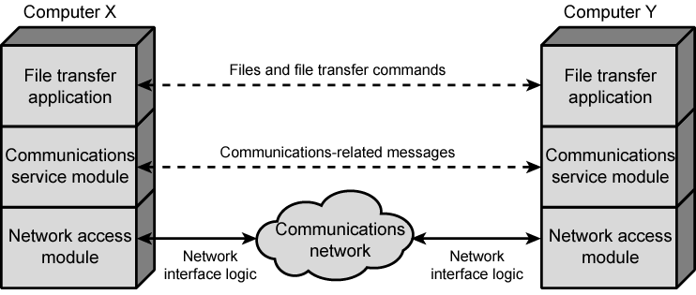
Simplified File Transfer Architecture

Slide 6
A Three Layer Model
Network Access Layer
Transport Layer
Application Layer

Slide 7
Network Access Layer
Exchange of data between the computer and the network
Sending computer provides address of destination
May invoke levels of service
Dependent on type of network used (LAN, packet switched etc.)

Slide 8
Transport Layer
Reliable data exchange
Independent of network being used
Independent of application

Slide 9
Application Layer
Support for different user applications
e.g. e-mail, file transfer

Slide 10
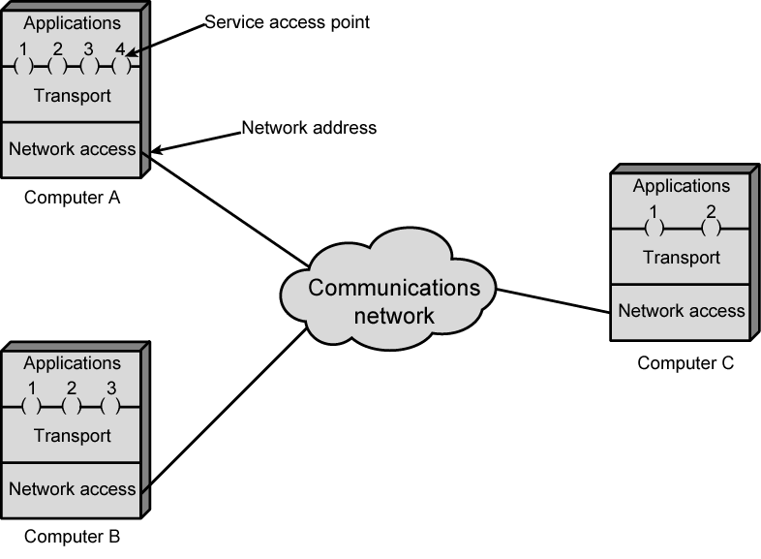
Protocol Architectures and Networks

Slide 11
Addressing Requirements
Two levels of addressing required
Each computer needs unique network address
Each application on a (multi-tasking) computer needs a unique address within the computer
  The service access point or SAP
  The port on TCP/IP stacks

Slide 12
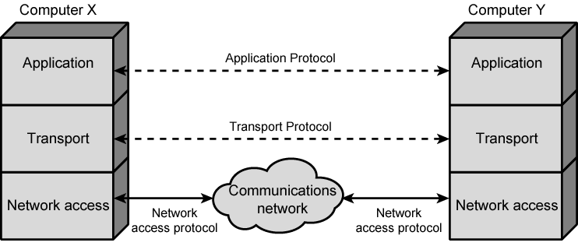
Protocols in Simplified Architecture

Slide 13
Protocol Data Units (PDU)
At each layer, protocols are used to communicate
Control information is added to user data at each layer
Transport layer may fragment user data
Each fragment has a transport header added
  Destination SAP
  Sequence number
  Error detection code
This gives a transport protocol data unit

Slide 14
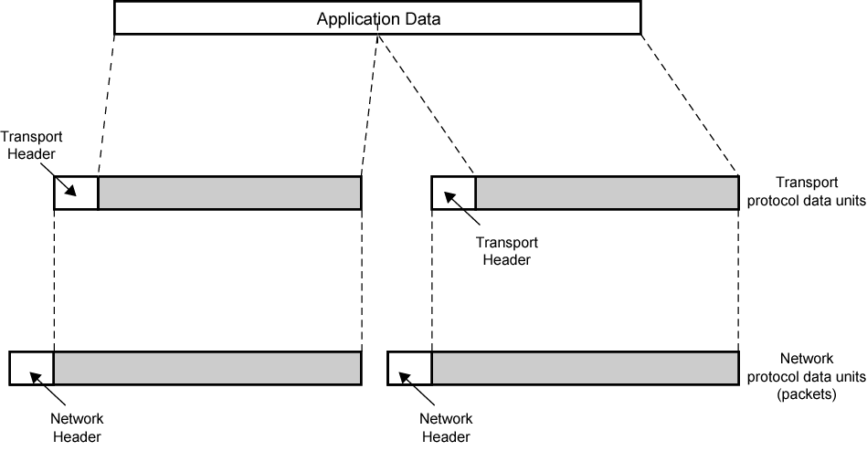
Protocol Data Units

Slide 15
Network PDU
Adds network header
  network address for destination computer
  Facilities requests

Slide 16
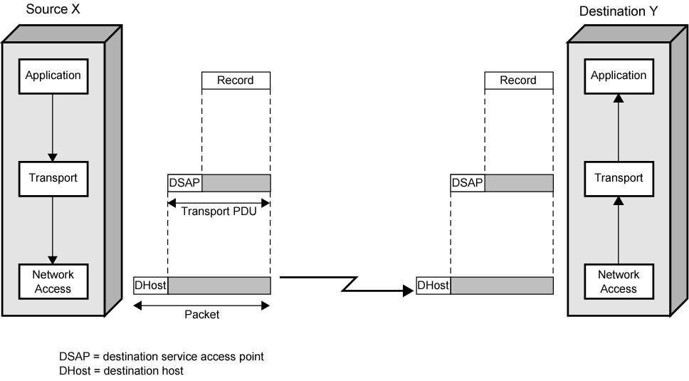
Operation of a Protocol Architecture

Slide 17
Standardized Protocol Architectures
Required for devices to communicate
Vendors have more marketable products
Customers can insist on standards based equipment
Two standards:
  OSI Reference model
    Never lived up to early promises
  TCP/IP protocol suite
    Most widely used
Also: IBM Systems Network Architecture (SNA)

Slide 18
OSI
Open Systems Interconnection
Developed by the International Organization for Standardization (ISO)
Seven layers
A theoretical system delivered too late!
TCP/IP is the de facto standard

Slide 19
OSI - The Model
A layer model
Each layer performs a subset of the required communication functions
Each layer relies on the next lower layer to perform more primitive functions
Each layer provides services to the next higher layer
Changes in one layer should not require changes in other layers

Slide 20
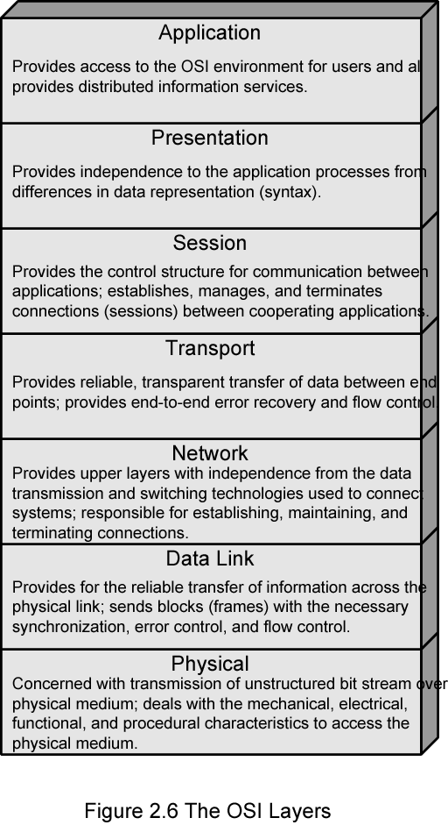
OSI Layers

Slide 21
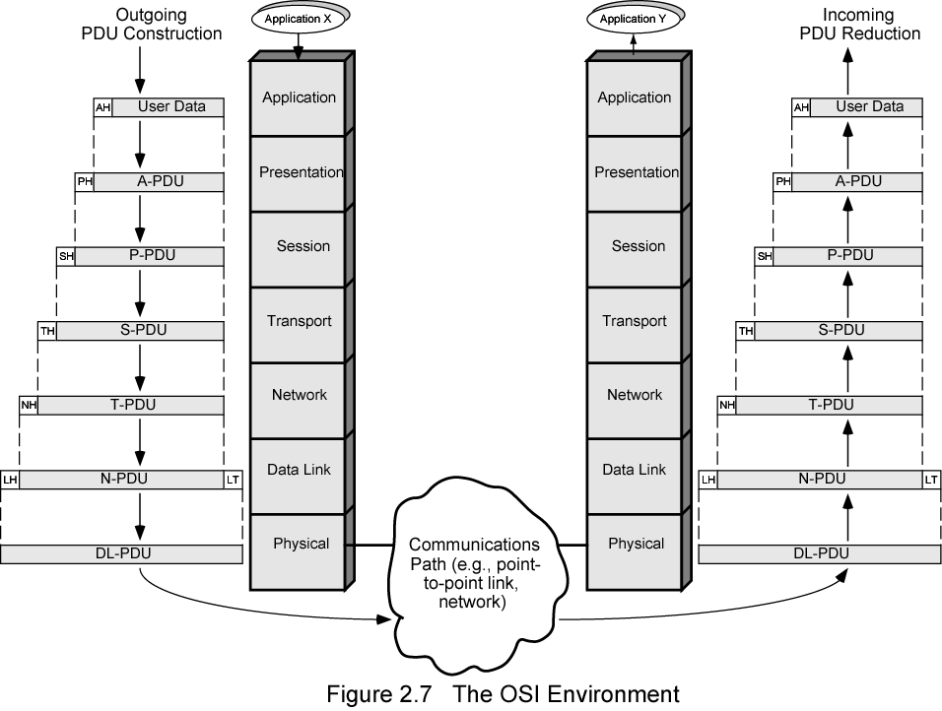
The OSI Environment

Slide 22
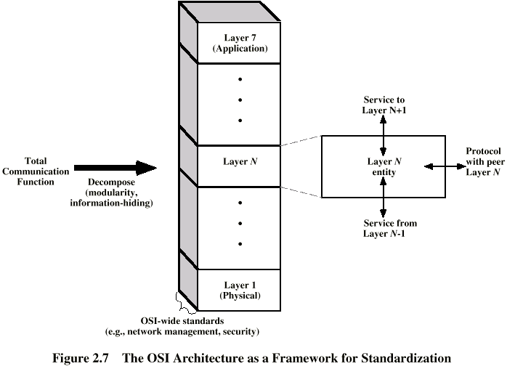
OSI as Framework for Standardization

Slide 23
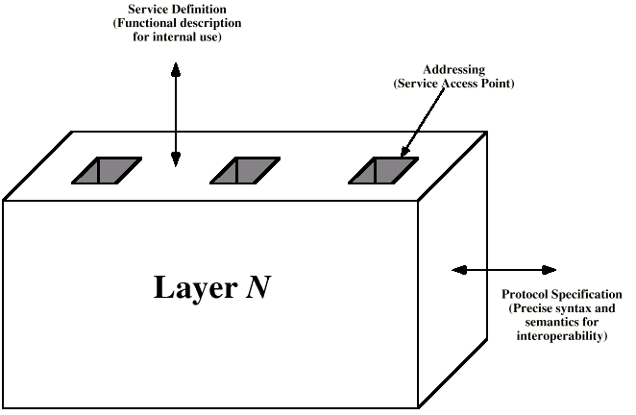
Layer Specific Standards

Slide 24
Elements of Standardization
Protocol specification
  Operates between the same layer on two systems
  May involve different operating system
  Protocol specification must be precise
    Format of data units
    Semantics of all fields
    allowable sequence of PCUs
Service definition
  Functional description of what is provided
Addressing
  Referenced by SAPs

Slide 25
Service Primitives and Parameters
Services between adjacent layers expressed in terms of primitives and parameters
Primitives specify function to be performed
Parameters pass data and control info

Slide 26
Primitive Types
REQUEST | A primitive issued by a service user to invoke some service and to pass the parameters needed to specify fully the requested service
INDICATION | A primitive issued by a service provider either to: indicate that a procedure has been invoked by the peer service user on the connection and to provide the associated parameters, or notify the service user of a provider-initiated action
RESPONSE | A primitive issued by a service user to acknowledge or complete some procedure previously invoked by an indication to that user
CONFIRM | A primitive issued by a service provider to acknowledge or complete some procedure previously invoked by a request by the service user

Slide 27
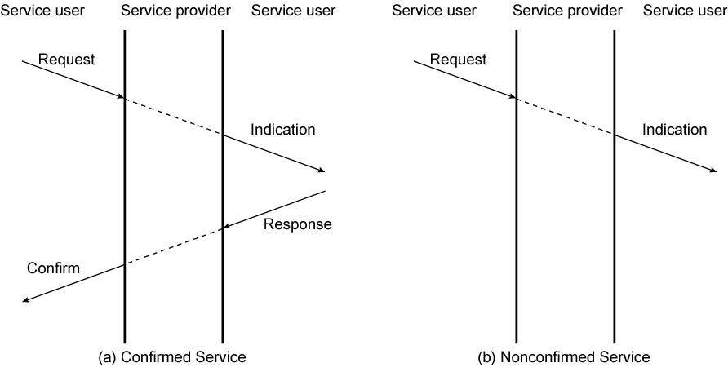
Timing Sequence for Service Primitives

Slide 28
OSI Layers (1)
Physical
  Physical interface between devices
    Mechanical
    Electrical
    Functional
    Procedural
Data Link
  Means of activating, maintaining and deactivating a reliable link
  Error detection and control
  Higher layers may assume error free transmission

Slide 29
OSI Layers (2)
Network
  Transport of information
  Higher layers do not need to know about underlying technology
  Not needed on direct links
Transport
  Exchange of data between end systems
  Error free
  In sequence
  No losses
  No duplicates
  Quality of service

Slide 30
OSI Layers (3)
Session
  Control of dialogues between applications
  Dialogue discipline
  Grouping
  Recovery
Presentation
  Data formats and coding
  Data compression
  Encryption
Application
  Means for applications to access OSI environment

Slide 31
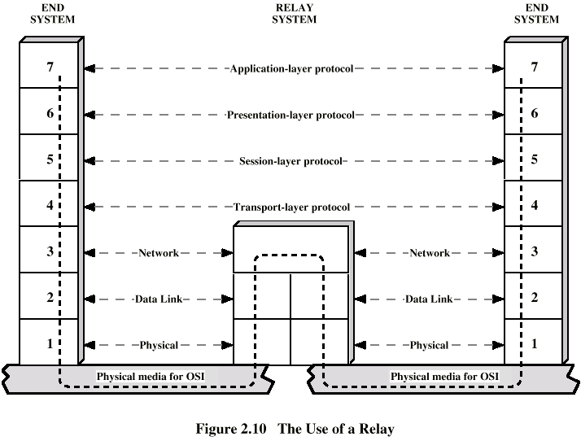
Use of a Relay

Slide 32
TCP/IP Protocol Architecture
Developed by the US Defense Advanced Research Project Agency (DARPA) for its packet switched network (ARPANET)
Used by the global Internet
No official model but a working one.
  Application layer
  Host to host or transport layer
  Internet layer
  Network access layer
  Physical layer

Slide 33
Physical Layer
Physical interface between data transmission device (e.g. computer) and transmission medium or network
Characteristics of transmission medium
Signal levels
Data rates
etc.

Slide 34
Network Access Layer
Exchange of data between end system and network
Destination address provision
Invoking services like priority

Slide 35
Internet Layer (IP)
Systems may be attached to different networks
Routing functions across multiple networks
Implemented in end systems and routers

Slide 36
Transport Layer (TCP)
Reliable delivery of data
Ordering of delivery

Slide 37
Application Layer
Support for user applications
e.g. http, SMPT

Slide 38
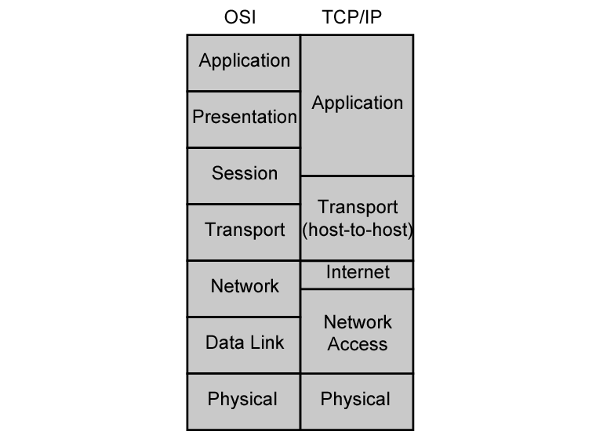
OSI v TCP/IP

Slide 39
TCP
Usual transport layer is Transmission Control Protocol
  Reliable connection
Connection
  Temporary logical association between entities in different systems
TCP PDU
  Called TCP segment
  Includes source and destination port (c.f. SAP)
    Identify respective users (applications)
    Connection refers to pair of ports
TCP tracks segments between entities on each connection

Slide 40
UDP
Alternative to TCP is User Datagram Protocol
Not guaranteed delivery
No preservation of sequence
No protection against duplication
Minimum overhead
Adds port addressing to IP

Slide 41
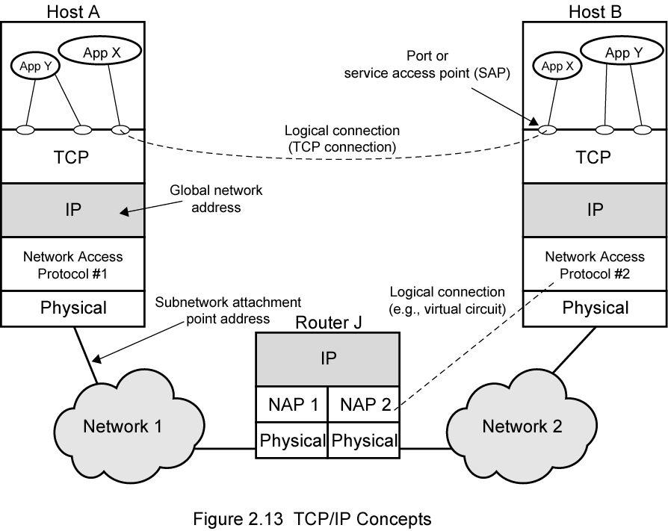
TCP/IP Concepts

Slide 42
Addressing level
Level in architecture at which entity is named
Unique address for each end system (computer) and router
Network level address
  IP or internet address (TCP/IP)
  Network service access point or NSAP (OSI)
Process within the system
  Port number (TCP/IP)
  Service access point or SAP (OSI)

Slide 43
Trace of Simple Operation
Process associated with port 1 in host A sends message to port 2 in host B
Process at A hands down message to TCP to send to port 2
TCP hands down to IP to send to host B
IP hands down to network layer (e.g. Ethernet) to send to router J
Generates a set of encapsulated PDUs

Slide 44
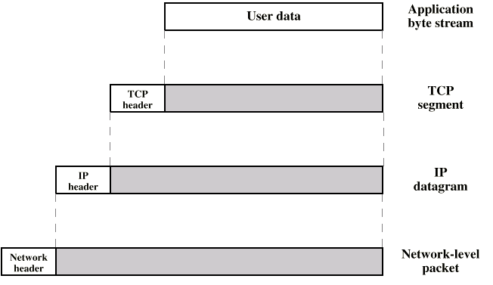
PDUs in TCP/IP

Slide 45
Example Header Information
Destination port
Sequence number
Checksum

Slide 46
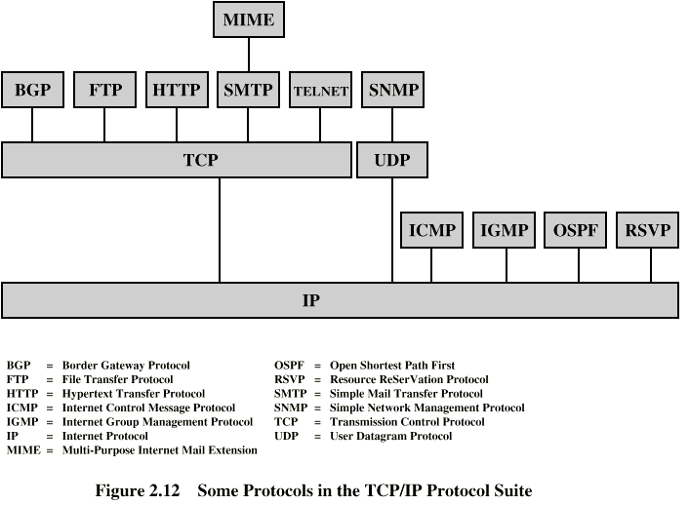
Some Protocols in TCP/IP Suite

